Slide 1
Lecture 3: CSS

Slide 2

Submit Homework
steve_fuller@berkeley.edu
Make sure you have submitted your designs
Homepage
About Page
Discography

Slide 3
CSS: Last Week Review
More in depth look into HTML
Why HTML is important
Browsers are designed to render HTML
HTML has 3 main components
Text
References
Markup
Parts of HTML Doc
Set up working ‘class-directory’
HTML Semantics
Learned what HTML is meant to do and not do
Elements, Attributes, and Values
Parent > Child relationships
URLs, linking items
File naming

Slide 4

CSS: Questions over reading
CH 7
Colors
Transparencies
URLs
Rules
Properties
etc.
CH 9
Selectors
Relationships
Pseudo Elements
Pseudo Classes
etc.

Slide 5
CSS: This week overview
What is CSS
Why is CSS important
Developer Tools
Class Directory
Adding external style sheets
Setting up
Naming files
URLs, Linking, Images

Slide 6

There’s going to be a lot to cover

Slide 7

CSS: Helpful Resources
StackOverflow - CSS
W3Schools - CSS
Can I Use?
CSS Cheat Sheet

Slide 8
CSS: What is CSS?
CSS stands for Cascading Stylesheets
CSS is NOT a programming language
Where HTML defines your contents meaning CSS defines the appearance
CSS can describe how HTML elements are displayed on
Screens
Paper
Other Media
External stylesheets are stored in .css files
Where HTML is more rigid, CSS there can be multiple way to do the same thing
Fun Fact: CSS1 was released proposed in ‘94 and released in ‘96

Slide 9
CSS: Solving a Big Problem
HTML was never intended for presentation
HTML was created to describe the content of a web page
HTML 3.2, released in ‘97, allowed for attributes to affect a web pages presentation
With CSS1 being released it was able to create a “separation of concerns” between presentation and content meaning

Slide 10
Open your class directory
Create a new HTML file called “css-basics.html”
Create a new CSS file called “css-basics-styles.css” inside your /stylesheets folder

Slide 11

CSS: Ways to add
CSS can be added in 3 way
Inline CSS
which is directly in HTML
<tag style=”width: 100px; ...” />
Not recommended
Internal/Embedded CSS
Using <style> tags
Use sparingly
External CSS
Using a .css file
Recommended

Slide 12
Demo CSS methods
(inline, internal, and external)

Slide 13

CSS: Rule

Slide 14
CSS: Constructing a Style Rule
Selector - identifies the element(s) you want to format
Property - a property is always associated with a Value
Value - is the allowable option(s) for a Property
p { color: red; }
p - is the selector
color - is the property
red - is the value
When using one or more properties attached to a selector you create a rule

Slide 15

Yeah this is intense I know

Slide 16
CSS Basics

Slide 17
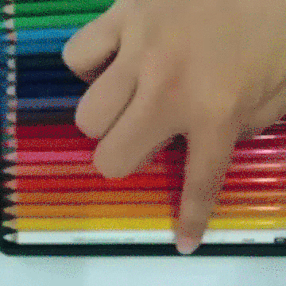
CSS: Colors
Colors can be defined in multiple ways
Name: red, yellow, purple aqua
Hexadecimal: #ff0000, #00ff00, #0000ff <<<<< Preferred
Hexadecimal Shorthand: #fff, #f0f, #00f
RGB: rgb(255, 255, 255)
Hue, Saturation, and Lightness: hsl(56, 100, 50)
RGBA & HSLA are the same as above but add a transparency property 1 > 0.0
Defining Colors in CSS

Slide 18
CSS: Fonts
Working with fonts is another big part of your sites presentation
Many browser have predetermined “Web Safe Fonts” which give you a set of fonts ready to use
Web Safe Fonts
Fonts in CSS have a lot of different properties such as:
font-family
font-size
font-weight
color
CSS Font Properties

Slide 19
CSS: Typography Properties
Aside from choosing a font family, size, and weight. You also have the ability to choose line-height and letter-spacing
CSS line-height - similar to Leading
CSS letter-spacing - similar to Kering
CSS word-spacing - similar to Tracking
CSS text

Slide 20
CSS: Selectors
There are many selectors to hook your CSS into your HTML
Class, most common
HTML <tag class=”hi”>...</tag>
CSS .hi{...}
Element
HTML <tag>...</tag>
CSS tag{...}
ID, for unique element per HTML page
HTML <tag id=”hi”>...</tag>
CSS #tag{...}
*, which is a “Universal Selector” and matches elements of any type
* {...}

Slide 21


Slide 22
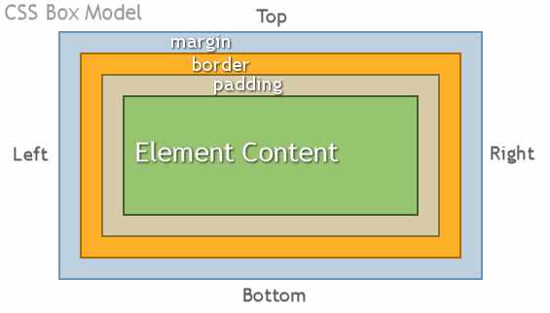
CSS: Box Model
Link

Slide 23
CSS: Box Model contd
All HTML elements can be considered boxes
In CSS, the term “box model” is used when talking about a layout
The Box Model is a box that wraps around every HTML Element
Content: your text, images, etc.
Padding: area around the content
Border: wraps around the padding
Margin: clears area around border
Another important topic is box-sizing which determines how your boxes are calculated

Slide 24
CSS: Shorthand
With many CSS properties you’ll see things written in 1 of 2 ways
.class{
margin-top: 10px;
margin-right: 5px;
margin-bottom: 10px;
margin-left: 5px;
}
Or in SHORTHAND
.class{
margin: 10px 5px;
}
CSS Shorthand Reference

Slide 25
CSS: Comments
Just like how you can make comments in HTML with <!-- this is an HTML comment →
You can do the same in CSS /* this is a css comment */

Slide 26


Slide 27
CSS: Layouts
Currently all our elements are taking up full horizontal width. This is because we are using block elements, But now we want to make a layout of sorts
CSS Float
This is a common way to create a layout for websites

Slide 28
CSS: Positioning
The position property specifies the type of positing method used for an element
Static - Default, not affected by top, bottom, left, and right properties
Relative - Positioned relative to normal position, affected by top, bottom, left, right
Fixed - Positioned relative to viewport, leaves no gaps affected by top, bottom, left, and right
Absolute - Positioned relative to nearest ancestor (usually inside Relative) affected by top, bottom, left, right
Sticky - positioned based on users scroll.
Link

Slide 29
CSS: Backgrounds
Backgrounds are yet another way you can really enhance the visual appeal of your site
Find a background image by google search
Save that file to your /assets/images/your-image.png
Create a div with a class background image
In your CSS reference your image as a “background-image”
background-image: url(‘../images/your-image.png”);
Try playing around with colors as well
CSS Background property

Slide 30

Hang in there I know...

Slide 31
CSS: Image Optimization
When talking about performance, images are a big way to increase performance
Download a LARGE Google Image
Open https://tinypng.com/
Drag & Drop or Select from filesystem
Compare Images
Do note I have seen issues with this and shadows on .png files with terrible results

Slide 32
CSS: Loading in Styles
CSS can be brought in with various methods
External Files
Embedded <style> blocks
Inline Styles
Open /class-directory
Within /assets/stylesheets
New File > styles.css
Add a Comment: /* CSS Comment */
Create css-styles.html
Add <style> tag in the head
Load in styles.css
<!doctype>
<html>
<head>
<title></title>
<link rel=”stylesheet” type=”text/css” href=”./assets/stylesheets/styles.css” />
<style></style>
</head>
<body><div class=”myBox”>...</div></body>
</html>

Slide 33

Week 3: Homework
Start Designing your Website
Designs for:
Media
Merch
Tour Dates
Read Chapters
12 & 14

